Slide 1

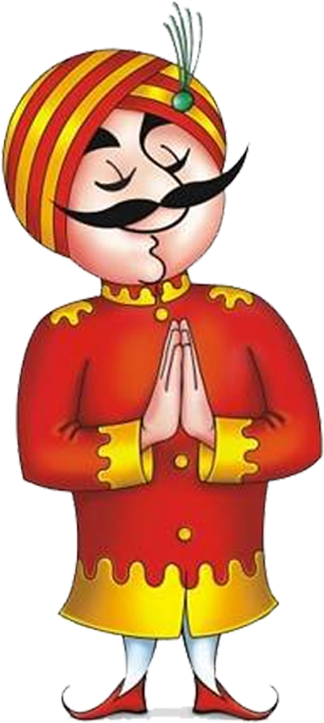
YESTERDAY, TODAY, AND TOMORROW
GROUP NO. 5
AADARSH – FT221001
ABHISEK KUMAR SHAW – FT221008
ASHISH SAMANT - FT221063
DEEP SINHA – FT221079
MANDAR KANDGE – FT222064

Slide 2
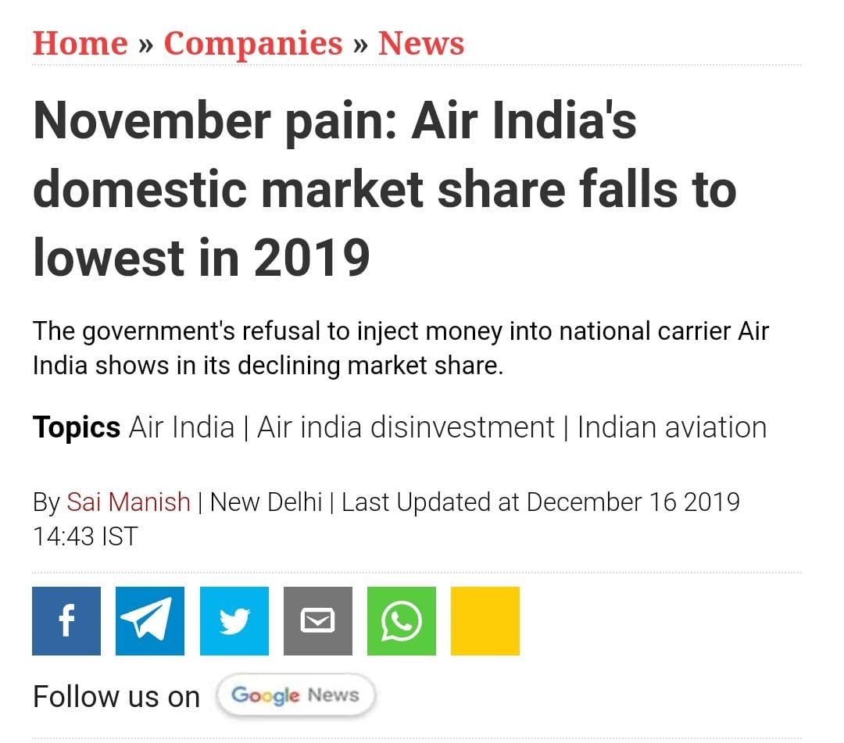
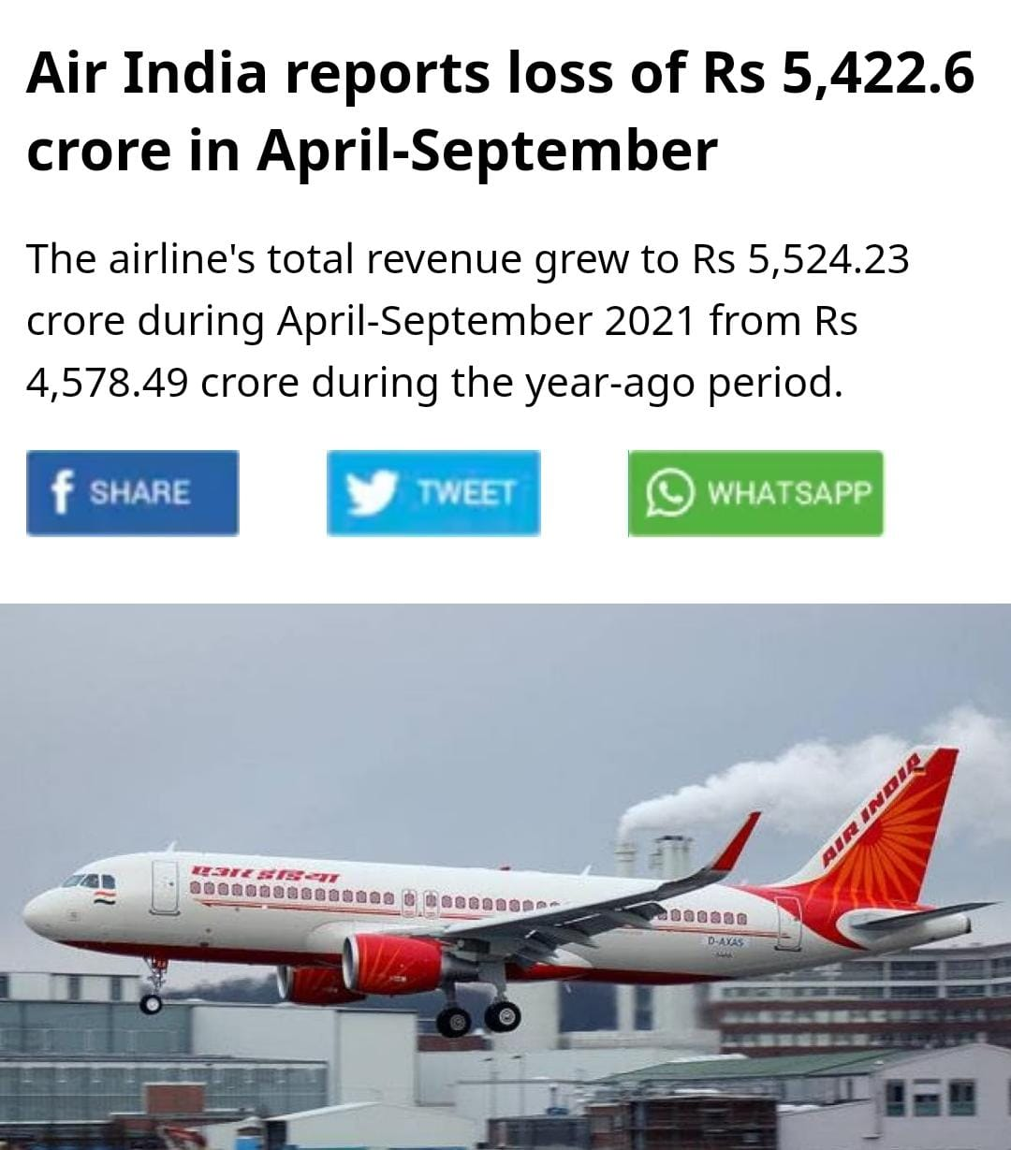
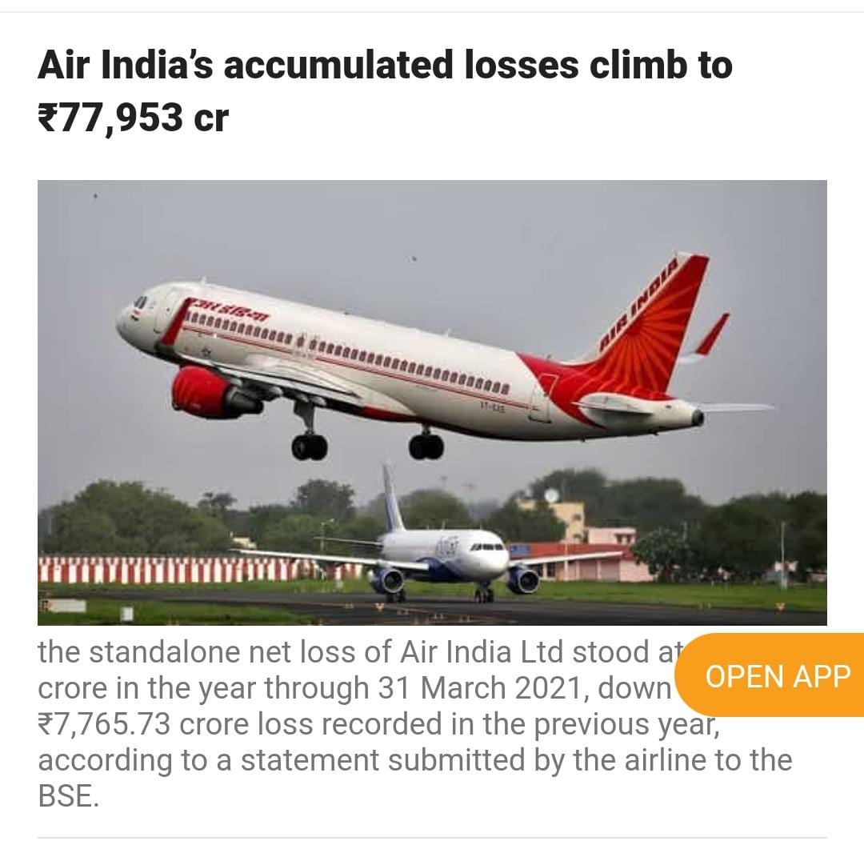
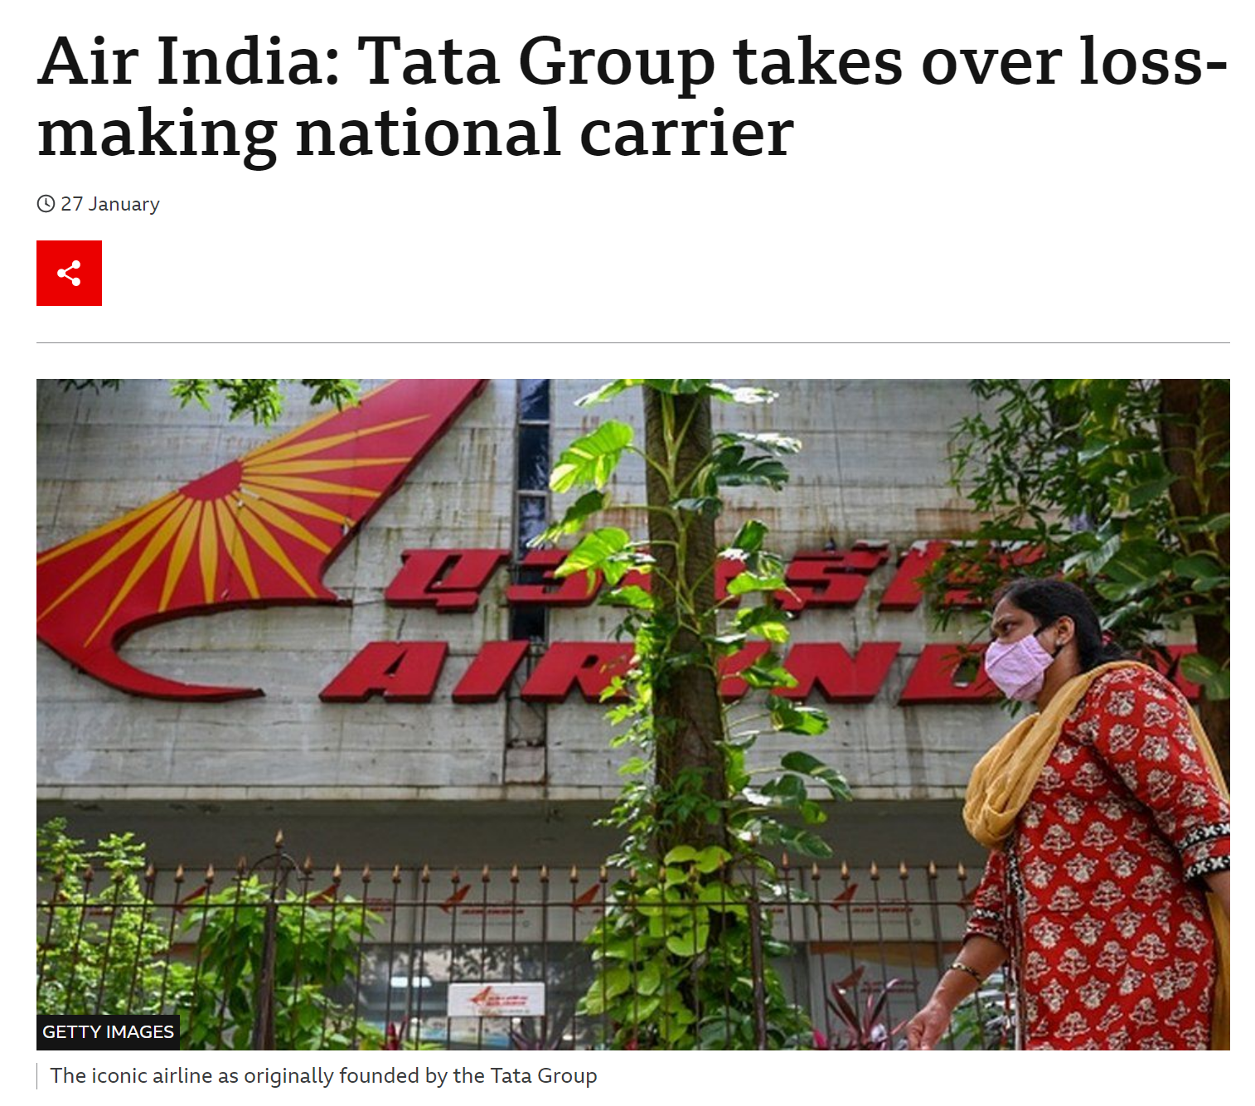
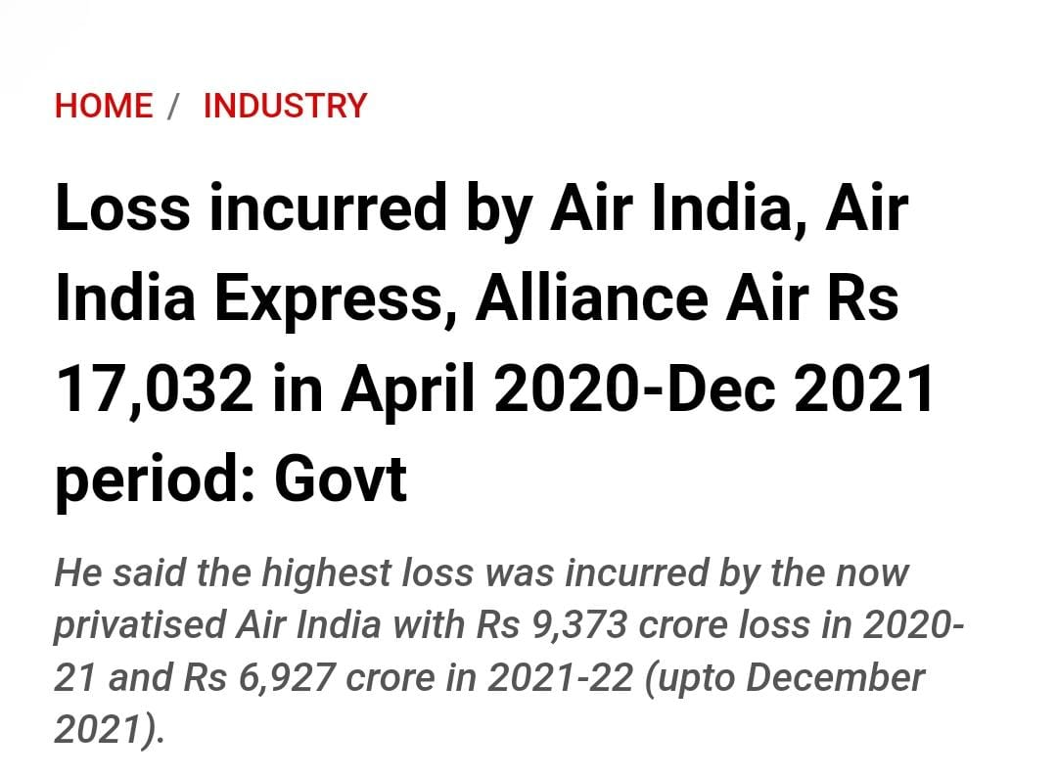
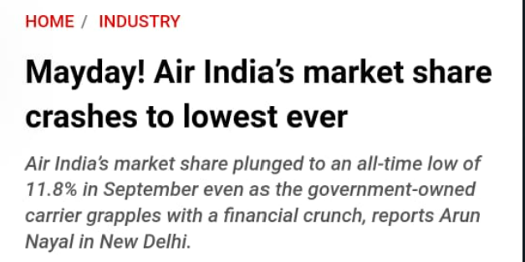

Slide 3
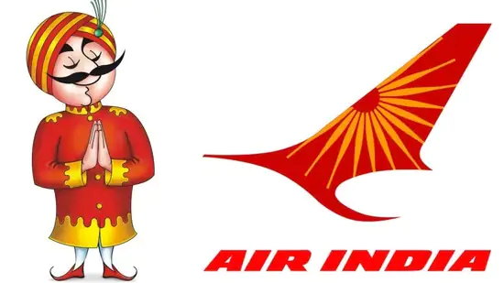
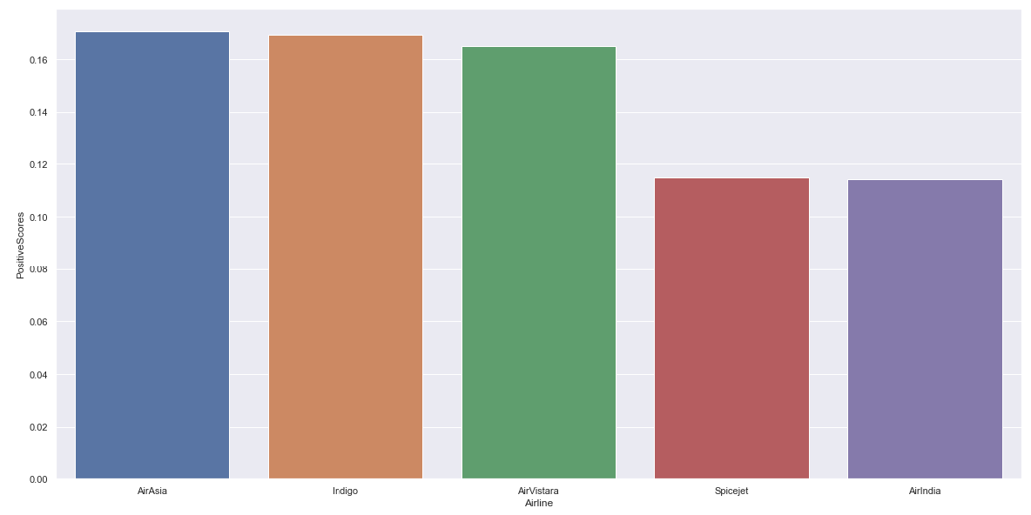
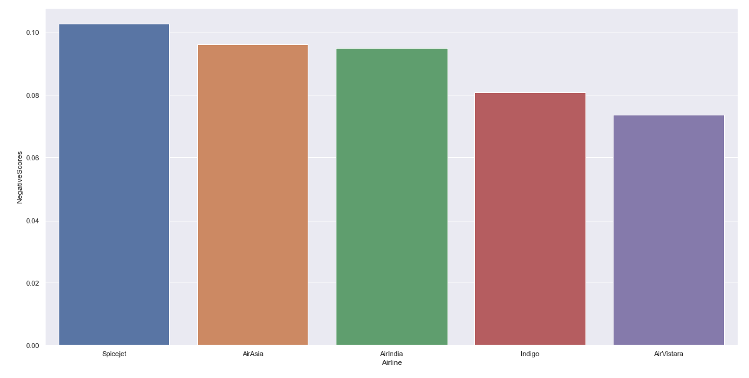
Overall sentiment of the Indian Airline Industry
Positive Sentiment
Air India has the lowest positive sentiment score ( 0.114292).
Air Asia and Indigo have the highest positive sentiment score.
Positive
0.170727
0.169122
0.164953
0.114683
0.114292
Negative
Negative Sentiment
Air India lies in the middle with 0.094935 score.
Spicejet and Air Asia have highest negative sentiment.
0.102761
0.096045
0.094935
0.080897
0.073783

Slide 4
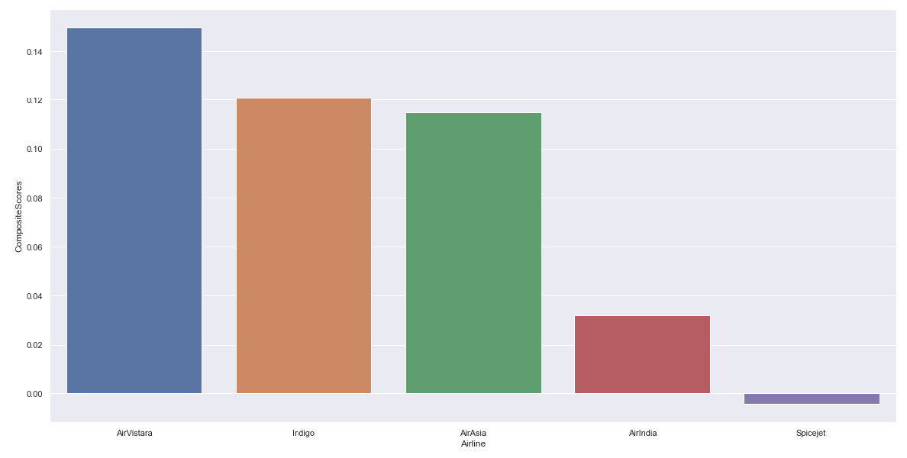
Overall sentiment of the Indian Airline Industry
Composite
Air India has the second lowest composite sentiment score ( 0.114292).
Air Vistara and Indigo have the highest composite score.
This indicates that there are some issues with the services offered by Air India.
0.149578
0.120816
0.114870
0.032185
-0.004202

Slide 5
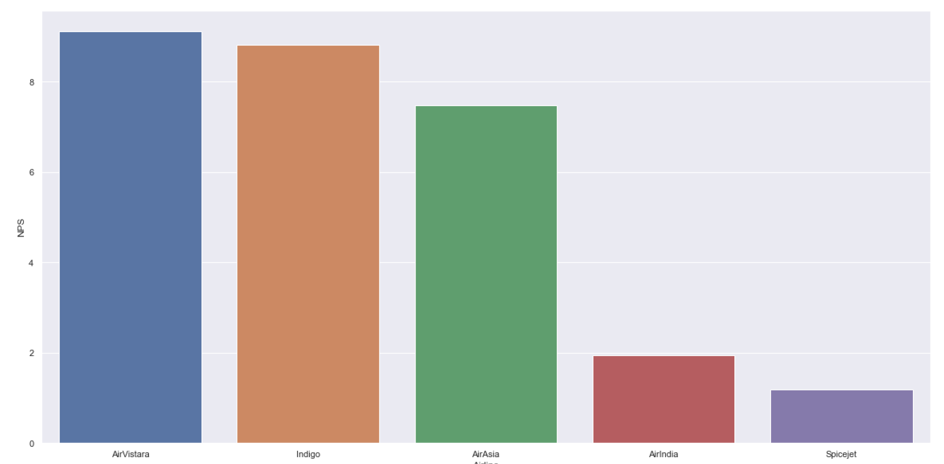
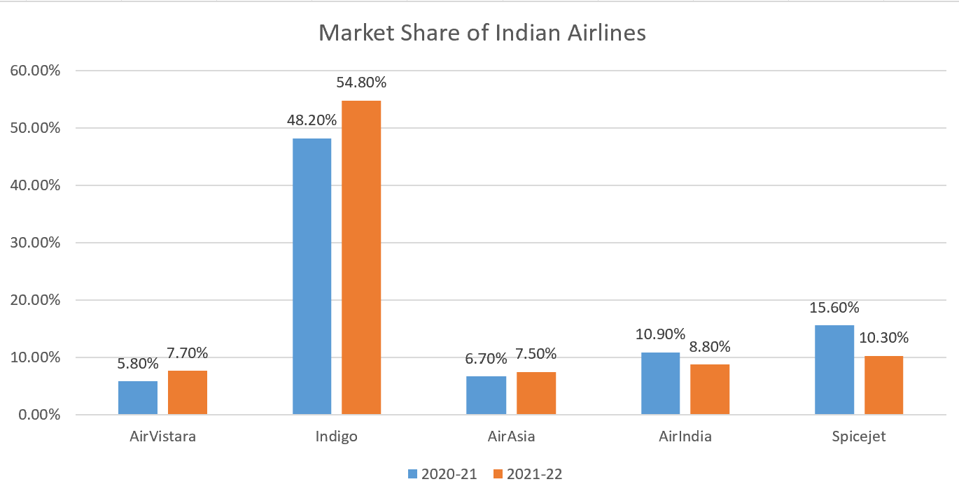
Impact of Sentiment on NPS and Market growth
According to a research by Bain and Company, Depending on the industry, on an average a 12 point increase in NPS corresponds to a doubling of a company’s growth rate.
9.12
8.82
7.47
1.94
1.19
When we looked at the Market Share of Airlines in the Indian Aviation Industry over 2 years, we found that
Air Vistara, Indigo, and Air Asia have seen a growth in their market share.
Air India and Spice Jet has seen a decline.
This directly correlates with the NPS analysis done in the previous slides.
Thus, there exists a positive correlation between a company’s market growth and NPS.

Slide 6
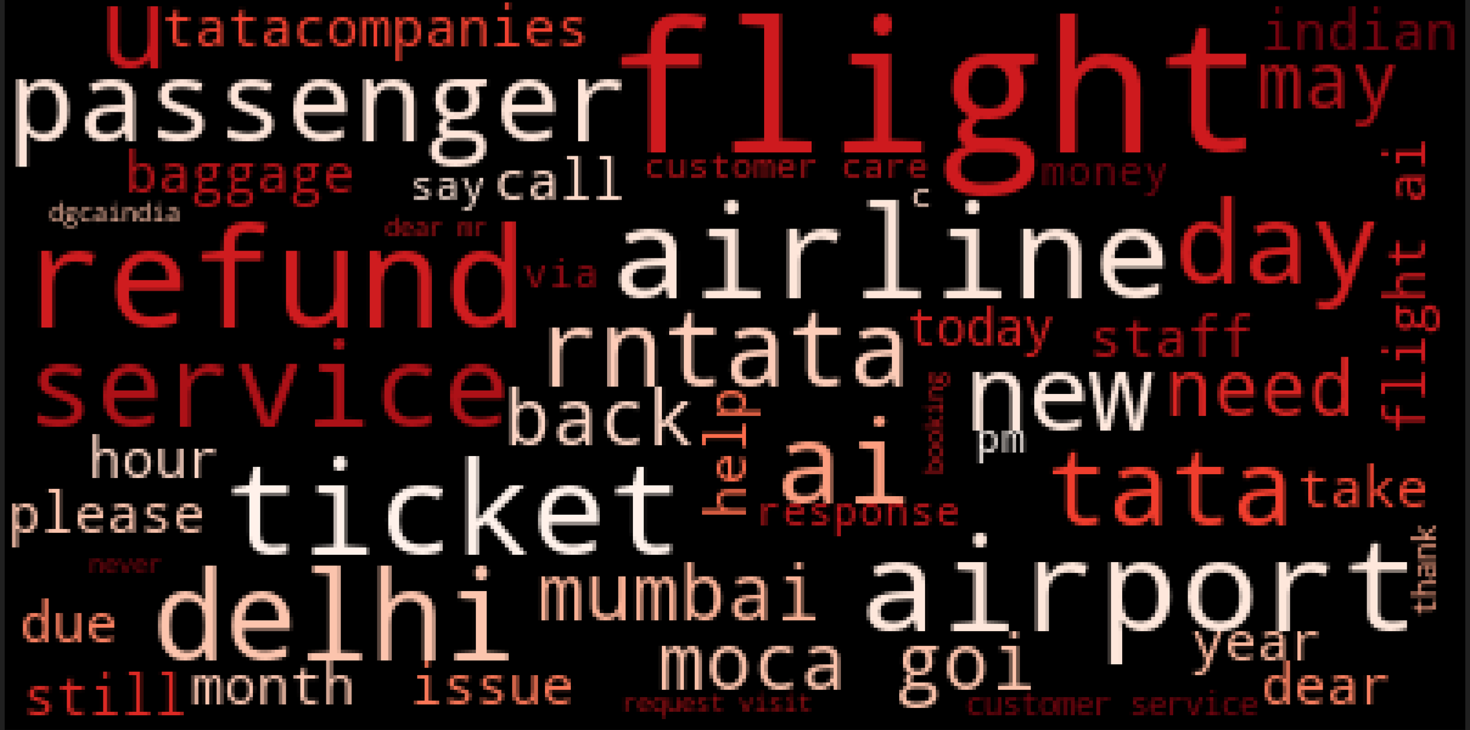
Issues with Air India - VOC
Passengers discussing about the baggage allowance and sharing their positive and negative thoughts.
Customer sharing their flight experience
Customer facing issues with refunds
Tata takeover of Air India is trending
Service quality issues faced by the customers
Customers facing some issues while traveling at the airports such as delays
Refund process due for many customers especially after COVID 19 pandemic
Management issues among Air India staff faced at Delhi and Mumbai airports in recent times.

Slide 7
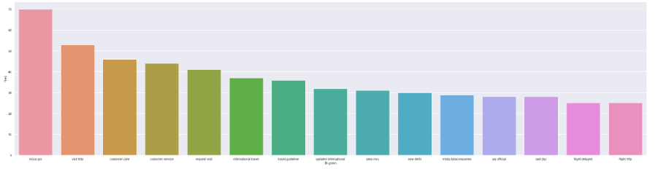
Issues with Air India - VOC
Customer Care service not able to respond to queries
Request for international travel guideline
Some issues at Delhi Airport
Flight Delay issues
Customer Service is poor

Slide 8
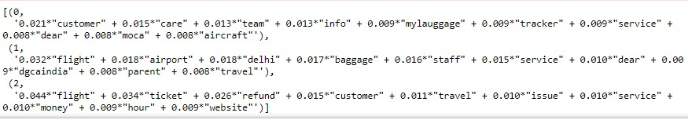
Let us try to model the issues in different buckets
Topic Modelling
Here we have done topic modelling of the different words. Mostly the words correlates to buckets – Customer Experience, Operational, Services/Service Quality.
In the code above, categorization is done.

Slide 9
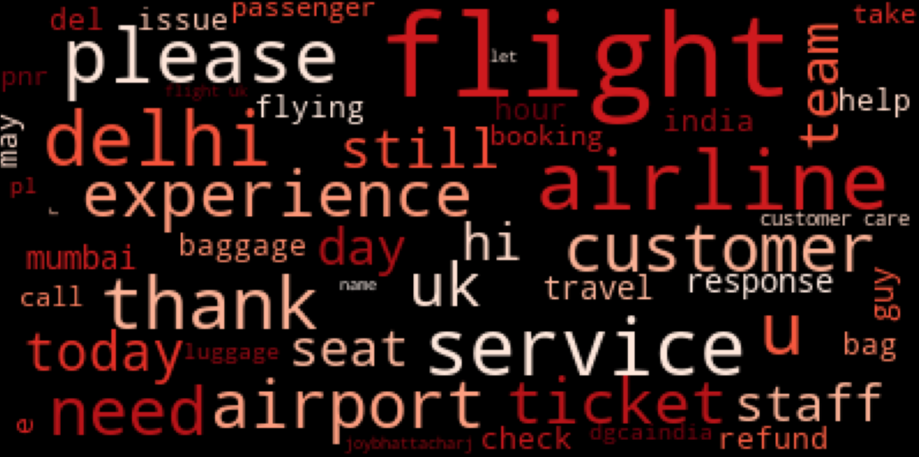
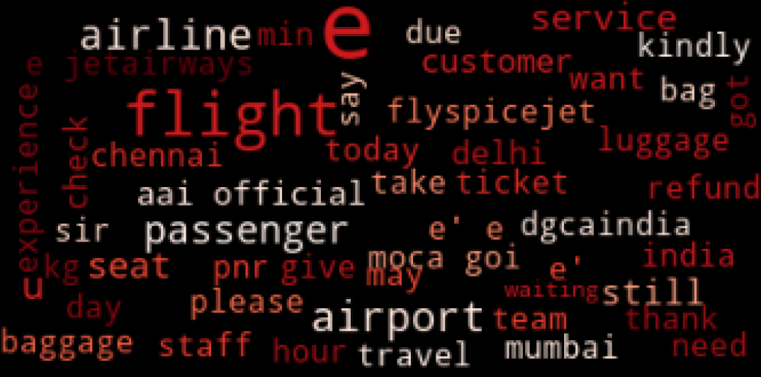
What has worked for the competitors?
Air Vistara
Text analysis of Air Vistara
We saw the words like thank and service appeared in huge numbers.
We found that customers appreciates –
Good food with good view,
LGBTQ people getting special recognition,
Good experience with customer support,
Getting requested seats,
Luggage exchange issues getting resolved quickly,
Multiple food options including vegan food and quick on refunds.
Text analysis of Indigo
Indigo offering cheap air fares with excellent customer support
Quick on refunds
Excellent cabin crew in terms on solving in flight issues.
Indigo

Slide 10
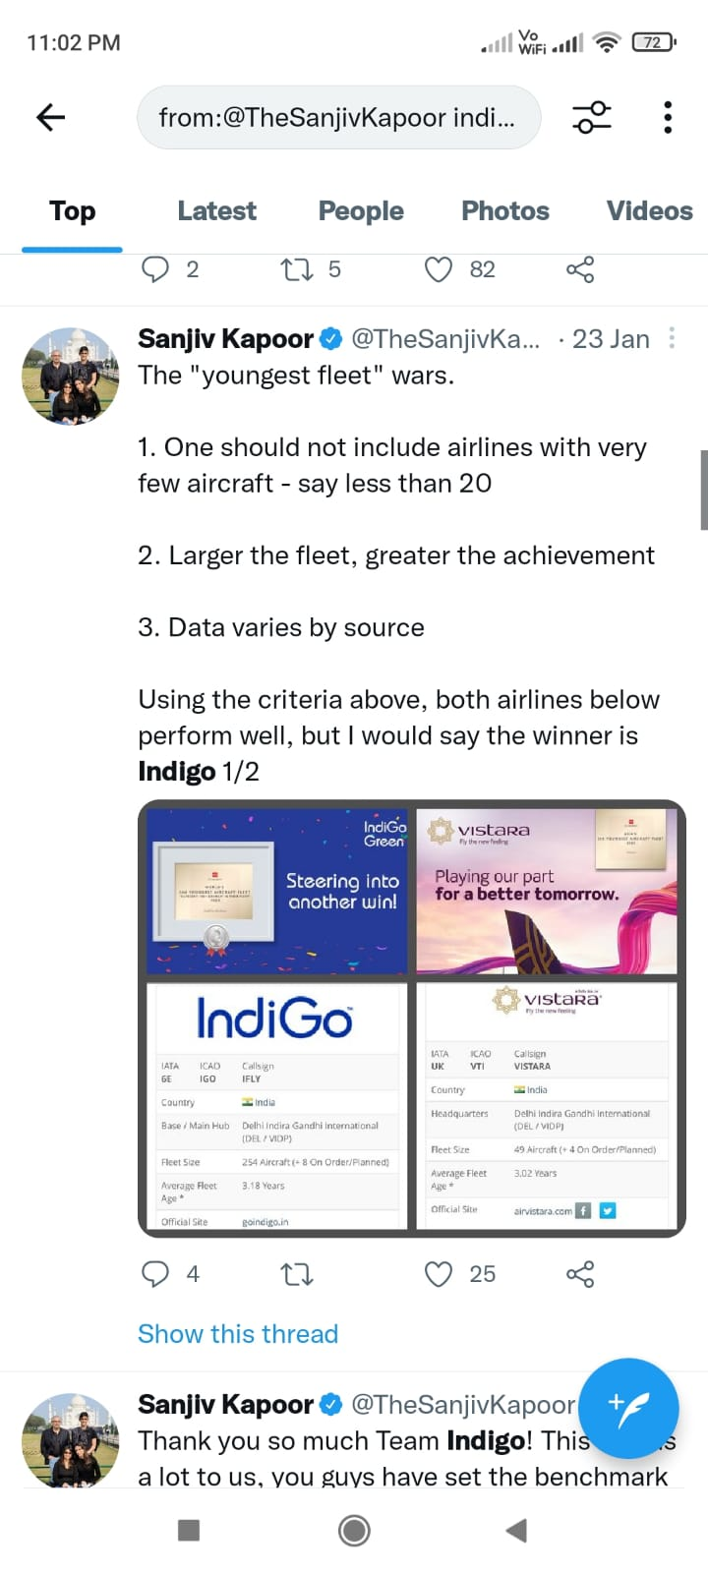
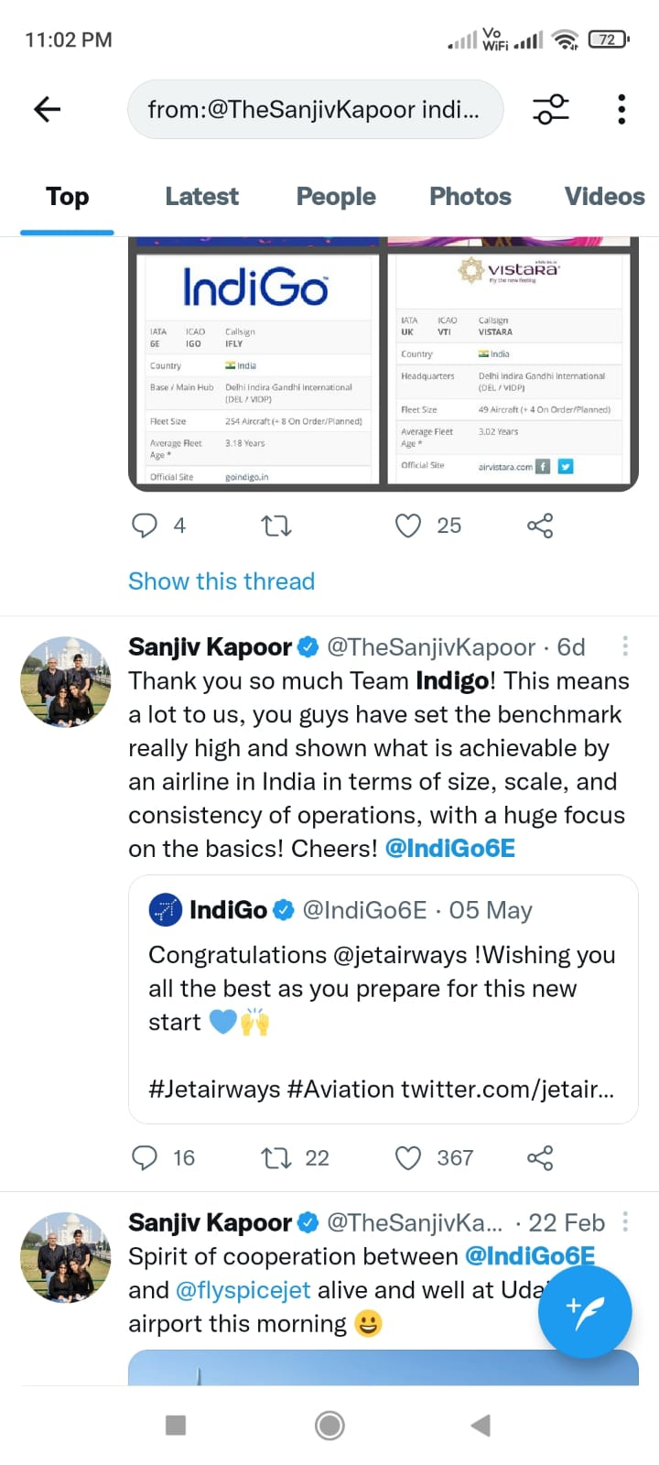
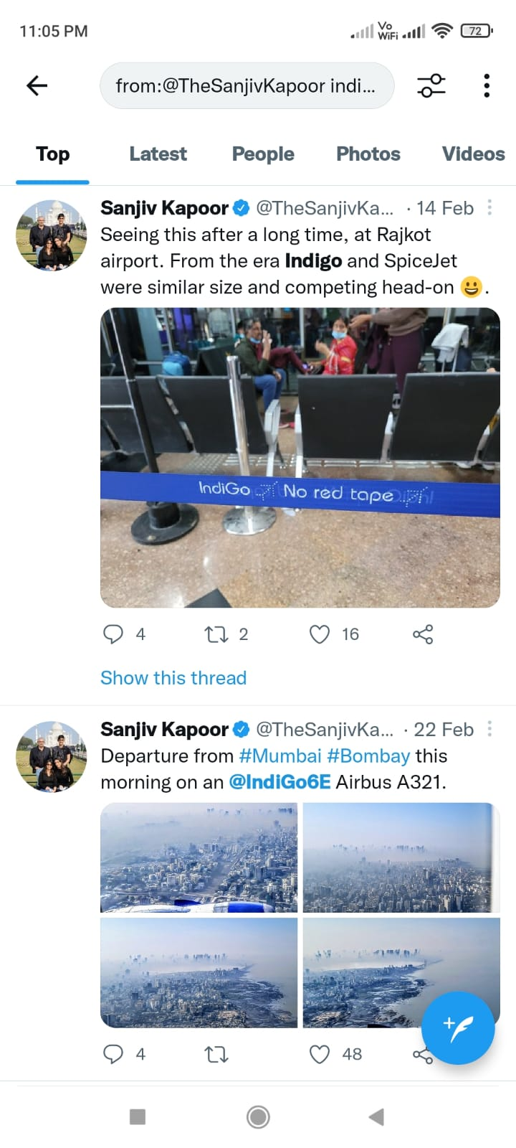
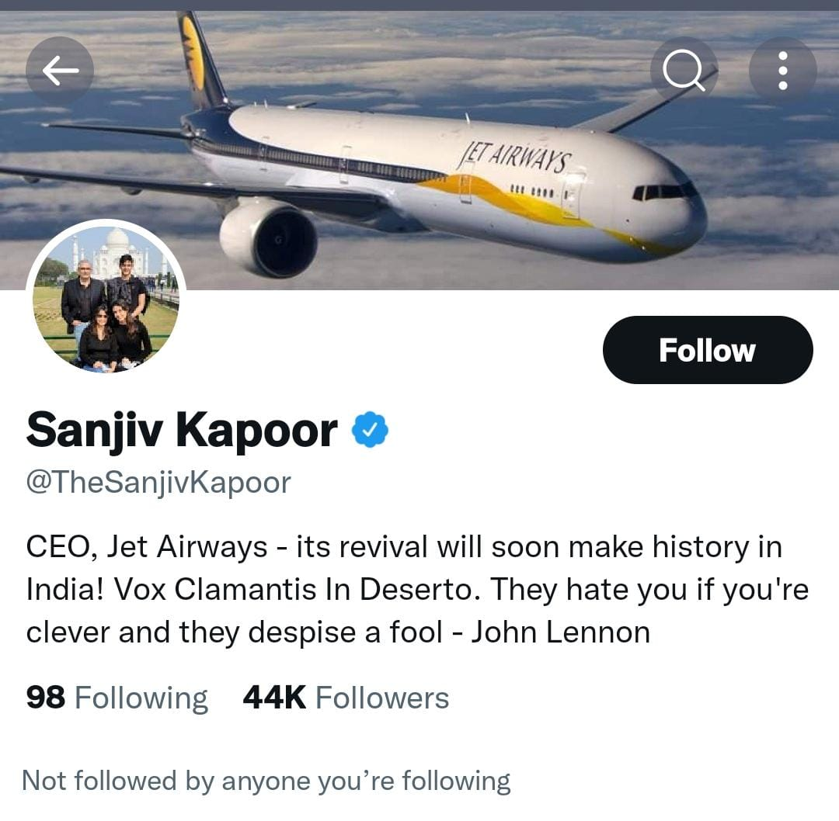
Social Media Marketing done by Indigo which Air India should implement
Sanjiv Kapoor, CEO Jet Airways has been appreciative towards Indigo’s performance and the benchmark they have set in the Indian Aviation Industry. His followers to friend ratio is very high making him a influencer and his tweets impacting the NPS
Indigo was successful in making its competitor their advocates building relations with the competitors.
Sanjeev Kapoor’s followers by friend ratio –
44000/98 = 449
Having him in Indigo’s network increases the popularity Indigo

Slide 11
Recommendations for AIR INDIA
Air India needs to reduce the average waiting time during their customer service phone calls, which can be achieved through Six-sigma initiatives.
Air India needs to improve their turnaround time in terms of addressing customer grievances and their redressal on social media platforms such as Twitter, Facebook, Instagram, etc.
Air India should encourage customers to engage with their hashtags (#FlyWithAirIndia, #WingsOfChange) to share in-flight experiences and reward the customers for the same.
Air India needs to focus on tackling issues related to misplaced and damaged baggage and minimize operational delays.
Air India needs to increase their positive sentiment through advocacy by influential people (As in the case of Indigo with Sanjeev Kapoor)
Air India should leverage the reputation of the Tata group to convince the customers that a technological and cultural transformation after the acquisition is inevitable.

Slide 12
THANK YOU

